Slide 1
Capstone Project Associate Data Analyst (Project 2)
Present by student - Ang Sheng Chang(Jeff)

Slide 2
Table of contents
01
02
03
04
05
Problem
Objectives
Data
The Problem Statement
The research objectives
Understand of the data and Preparation
ML Results
Conclusion
The result interpretations
Visualizations and Dashboards

Slide 3
01
Problem
The problem statement

Slide 4
Problem
Heart disease is a leading cause of mortality worldwide. Early detection and accurate prediction of heart disease can significantly improve patient outcomes by enabling timely intervention and preventive measures.
Notes:
It is about early detection of Heart disease.

Slide 5
02
Objectives
The research objectives

Slide 6
Objectives
The objective of this project is to develop a machine learning model that can effectively predict the presence or absence of heart disease based on various medical and lifestyle factors.
Notes:
The keys are: Need a machine learning model to predict the presence or non presence of heart disease thru study of their lifestyle

Slide 7
03
Data
Understand of the data and Preparation

Slide 8
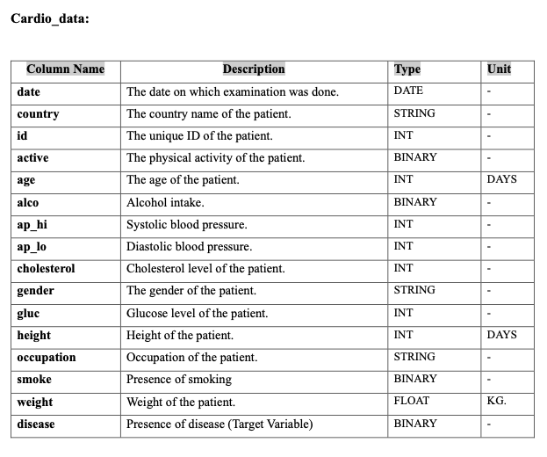
Understanding of the data
The only source from give csv dataset.
A number of these columns requires more preparations before fitting to Machine Learning Model.
Notes:
The only source of truths.

Slide 9
Data Preparation
One-hot encoding method is used in these following independent variables after formatting to some:
Age
Gender
Occupation
Country
ap_hi / ap_lo
Cholesterol
Gluc
Addition: BMI (Body Mass Index). Formula: bmi = weight/(height * height)

Slide 10
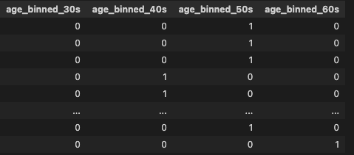

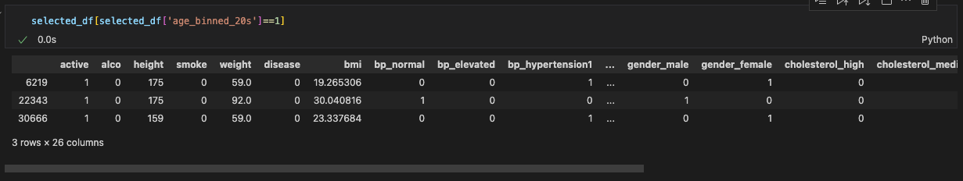
Age
Age given by default in terms of days. For easy classification. It is converted into age years then thereafter again are classified into these bins:
Up to 29 | 30 - 39 | 40 - 49 | 50 - 59 | Above 60
Subsequently, a separate column with binary 0 or 1 is created to this bins using one-hot binary method. Note that, Age 20s group is excluded because no enough data for prediction.

Slide 11
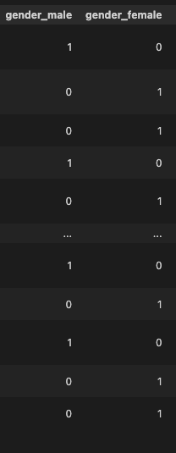
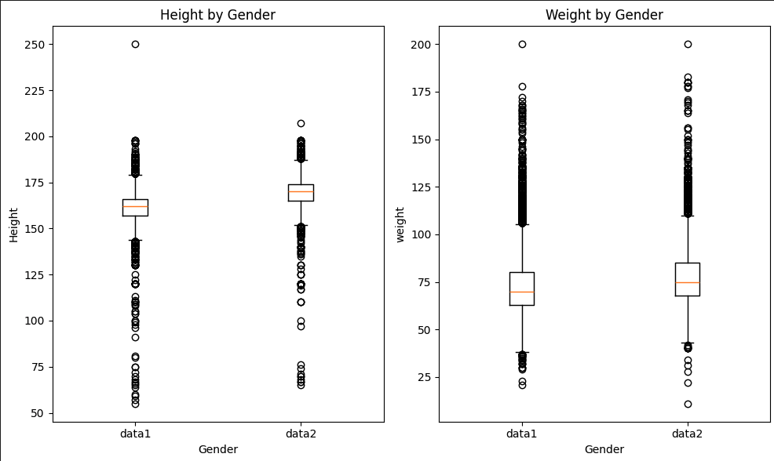
Gender
Gender is mapped into a seperate columns using one-hot encoding method.
1 | Female
2 | Male
Based on the common understanding that Male weights and taller than Females in general.
Notes:
The box plot shown here is used as a way to determine which one is males/females.

Slide 12
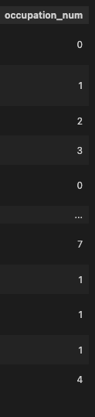
Occupation
Occupation is mapped into a number respectively.
Architect | 0
Accountant | 1
Chef | 2
Lawyer | 3
Teacher | 4
Nurse | 5
Engineer | 6
Doctor | 7
Others | 8

Slide 13

Country
Occupation is mapped into a number respectively.
Indonesia | 0
Malaysia | 1
Singapore | 2
India | 3

Slide 14
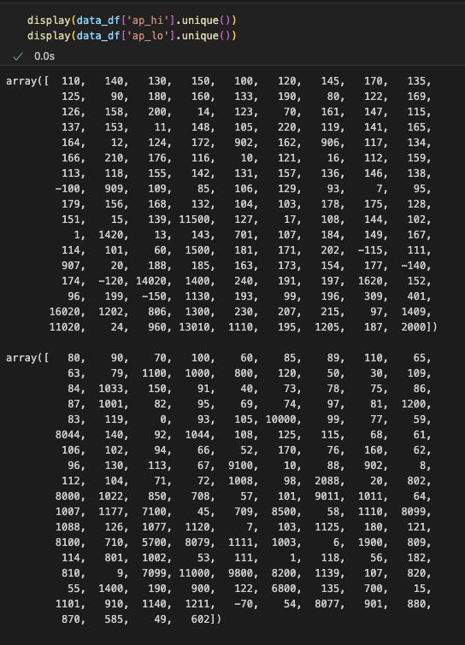
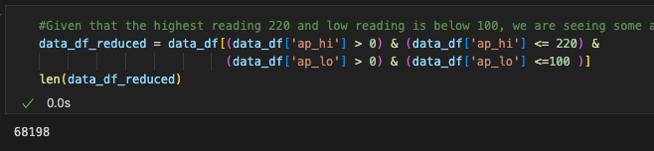
ap_hi / ap_lo
Abnormal values has been observed. Step has been implemented to filter them out.
Notes:
Systolic set limit as 220
Diastolic set limit as 100

Slide 15
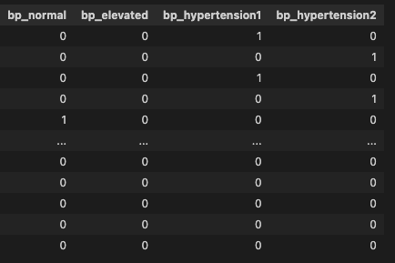
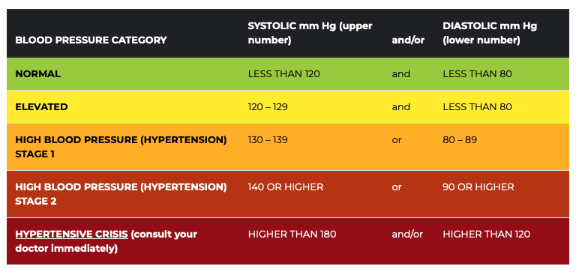

ap_hi / ap_lo
Blood pulse reading is categorized according to the below categories based on American Heart Association:
Additional check to ensure all records are filled:
Notes:
Result taken from American Heart Foundation website.

Slide 16
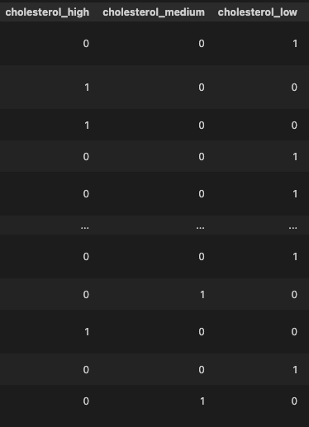
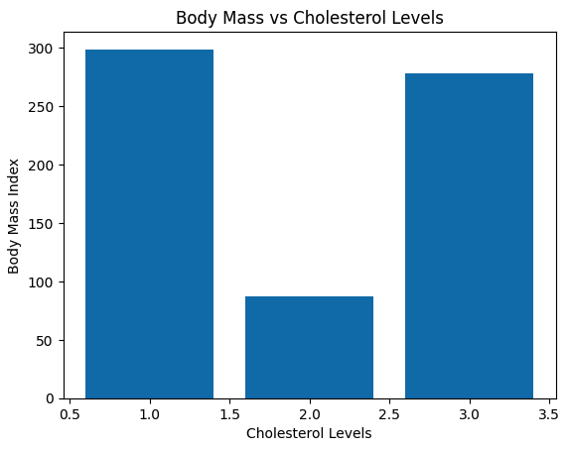
Cholesterol
Cholesterol is mapped into a number respectively.
1 | cholesterol_low
2 | cholesterol_medium
3 | cholesterol_high
Taking into account that there are real cases where person has BMI reading but low cholesterol. For an example, muscular man. So this is acceptable.

Slide 17
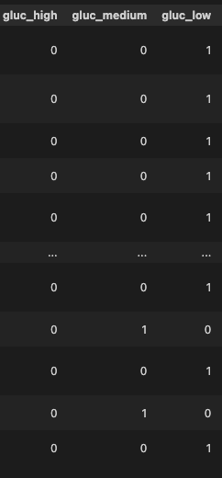
Gluc
Glucose Levels are mapped into a number respectively similar to Cholesterol.
1 | gluc_low
2 | gluc_medium
3 | gluc_high

Slide 18
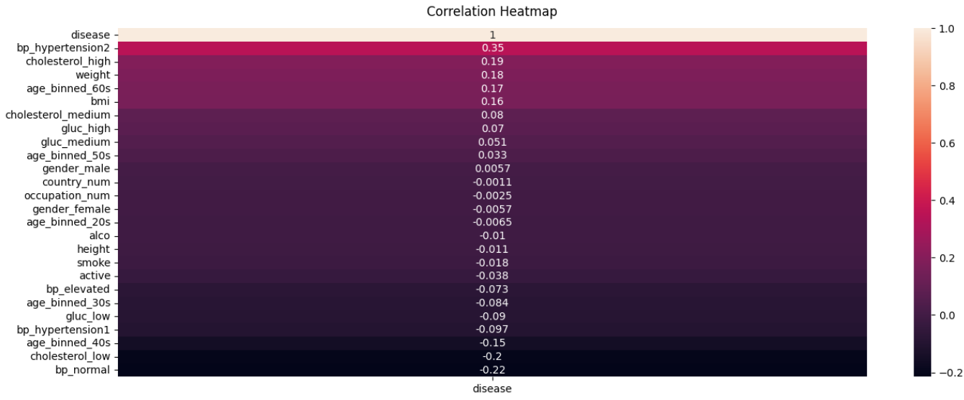
Correlation
A correlation of all parameters against target disease. It is showing out some clues.
Notes:
All correlation of independent variables against disease.

Slide 19
04
ML Results
The result interpretations

Slide 20
Methods Comparison
Logistic Regression
KNN
Decision Tree

Slide 21
What is the goal?
Ideally, we hope to see a model what is best fitting to the dataset. Meaning both Training and Test scores are consistent or at least very minor differences.
Being consistent, also means that there isn’t either Overfitting or Underfitting occurs on the model.

Slide 22
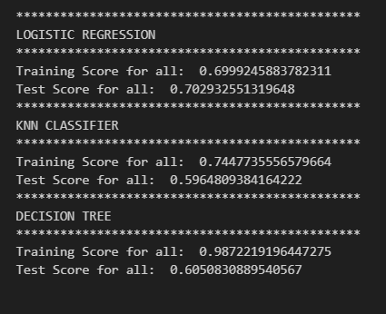
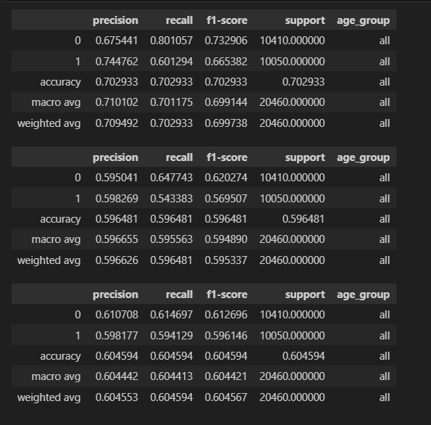
Full dataset scoring for different classifiers
LR
KNN
DTree
Notes:
In terms of performance, we can see that LR is better than the rest.

Slide 23
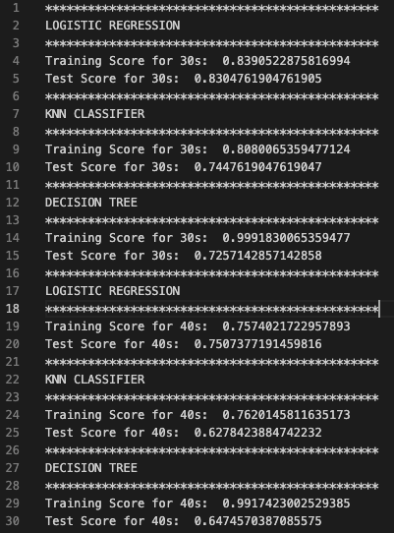
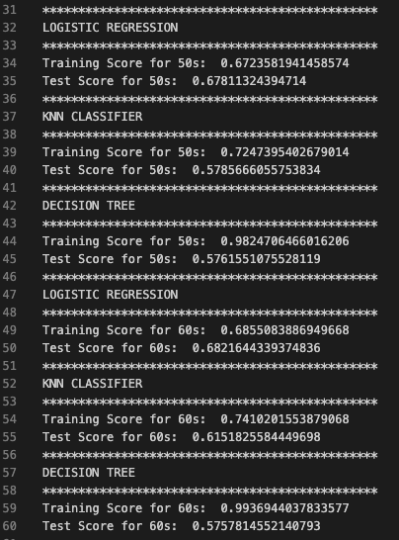
Individual Age Groups Scorings
Notes:
It would seems like there isn’t one size fits all. Another thing we can do is to test fitting by different age groups.

Slide 24

All test cases
 | Result(Logistic Regression) | Result(KNN) | Result(Decision Tree)
Full Dataset | Training Score for all: 0.6999245883782311 Test Score for all: 0.702932551319648 | Training Score for all: 0.7447735556579664 Test Score for all: 0.5964809384164222 | Training Score for all: 0.9872219196447275 Test Score for all: 0.6050830889540567
Age Group 30s | Training Score for 30s: 0.8390522875816994 Test Score for 30s: 0.8304761904761905 | Training Score for 30s: 0.8080065359477124 Test Score for 30s: 0.7447619047619047 | Training Score for 30s: 0.9991830065359477 Test Score for 30s: 0.7352380952380952
Age Group 40s | Training Score for 40s: 0.7574021722957893 Test Score for 40s: 0.7507377191459816 | Training Score for 40s: 0.7620145811635173 Test Score for 40s: 0.6278423884742232 | Training Score for 40s: 0.9917423002529385 Test Score for 40s: 0.6401666377365041
Age Group 50s | Training Score for 50s: 0.6723581941458574 Test Score for 50s: 0.67811324394714 | Training Score for 50s: 0.7247395402679014 Test Score for 50s: 0.5785666055753834 | Training Score for 50s: 0.9824706466016206 Test Score for 50s: 0.5786630654962863
Age Group 60s | Training Score for 60s: 0.6855083886949668 Test Score for 60s: 0.6821644339374836 | Training Score for 60s: 0.7410201553879068 Test Score for 60s: 0.6151825584449698 | Training Score for 60s: 0.9936944037833577 Test Score for 60s: 0.5747307591279223
These were the runs performed(Training: 0.70, Test: 0.30, with random state of 42.):

Slide 25
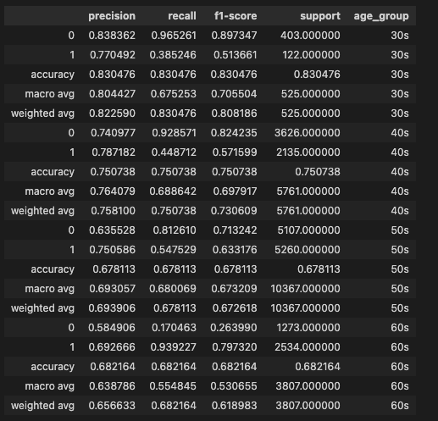
Individual Age Group Classification Report Evaluation
Result by Logistic Regression
Both Precision and Recall are high.
High Recall means the sensitivity of finding all cases.
Notes:
To recall, our objective is to detect the 0 and 1.
On this evaluation report itself we can see some interesting numbers.
Place of interest here are the 30s and 60s.
For 0 cases, both precision and recall are high reading. Indicates it is ideal.
For 1 cases, high Recall that is the sensitivity of detecting disease which is more favorable though precision is just 69%.
In both cases, if we take a moderate approach of using f1-score of casting these 2 readings into one digit. The numbers are still useful.

Slide 26
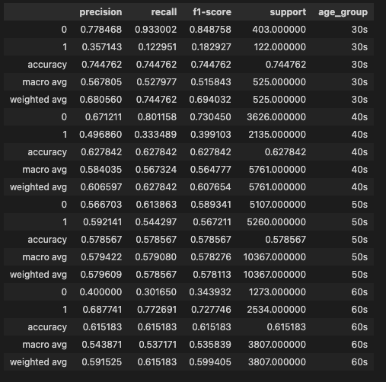
Individual Age Group Classification Report
Result by KNN

Slide 27
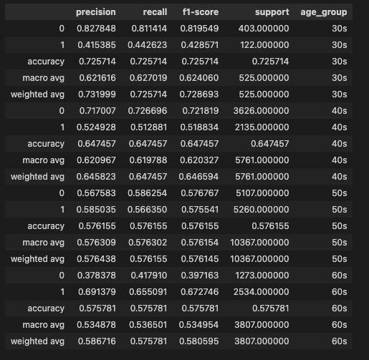
Individual Age Group Classification Report
Result by Decision Tree

Slide 28
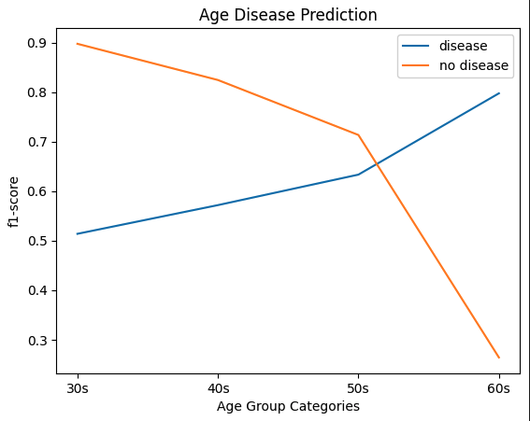
F1-Score vs Age Group Categories

Slide 29
05
Conclusion
Visualizations and Dashboards

Slide 30
Some ideas
Based on the heatmap earlier, that gives us some ideas to work on.
There are some areas possible to carry out our analysis:
The blood pulse classifications on different age group.
The percentage of smoker vs non-smoker.
Different occupations grouping.
The percentage of physical activeness by country.
The number of cholesterol levels by Glucose levels.
The overall number of Body Mass Index by Gender.

Slide 31
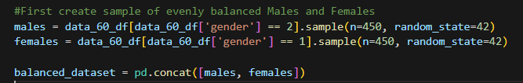

Sample Size
The difference of gender size between age group 30s and 60s.
 | Age Group 30s data size | Age Group 60s data size
Female (1) | 847 | 5542
Males (2) | 494 | 2902
To ensure consistent comparison, we randomly pick 450 females/males from each age group.

Slide 32
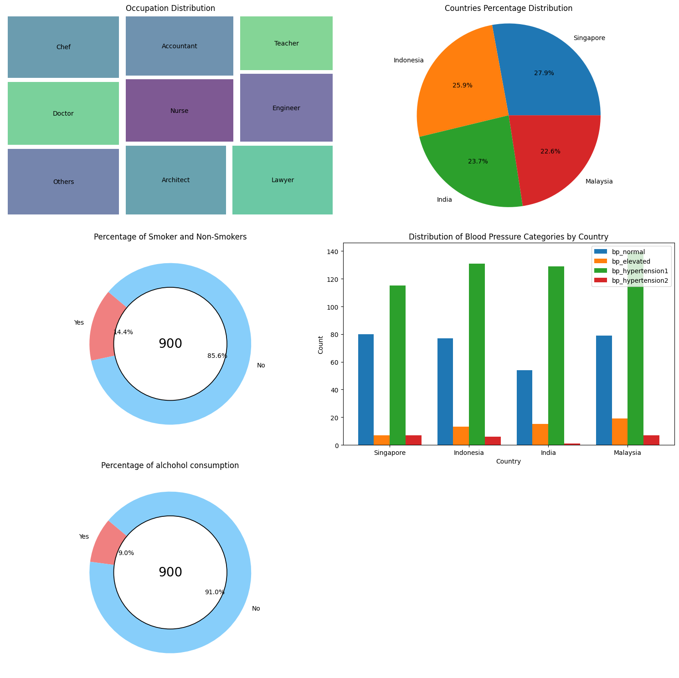
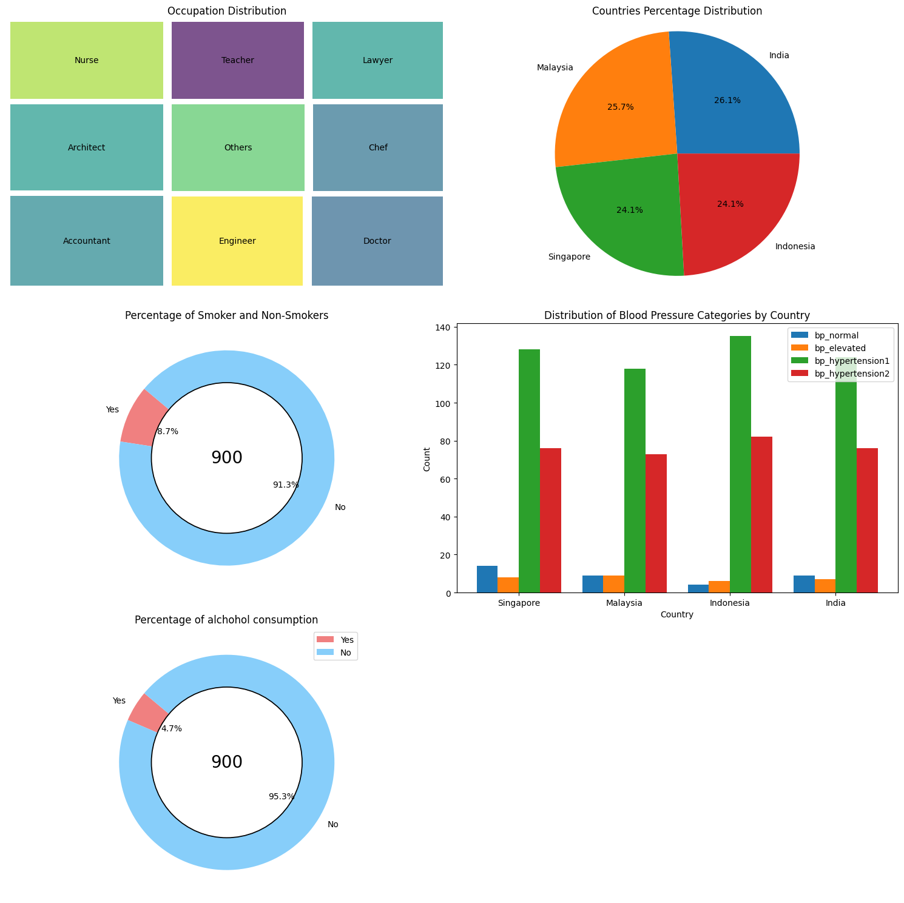
Age group 30s Profile
Age group 60s Profile

Slide 33
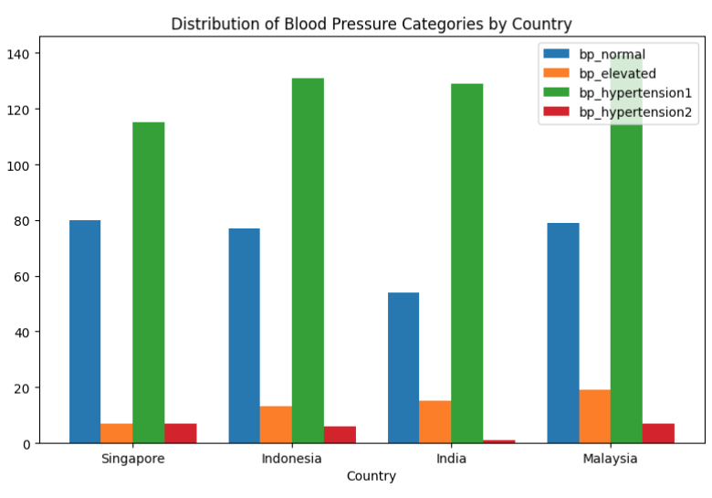
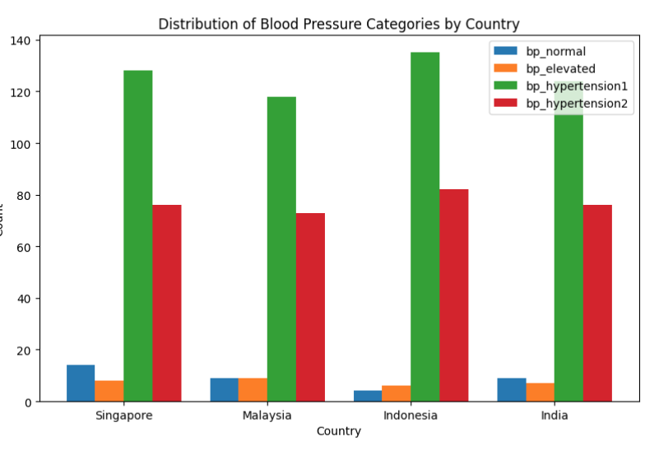
Attention! Blood Pulse
Age group 30s Profile
Age group 60s Profile
Notes:
More cases with hypertension stage 2

Slide 34
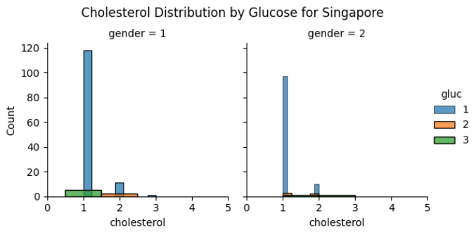
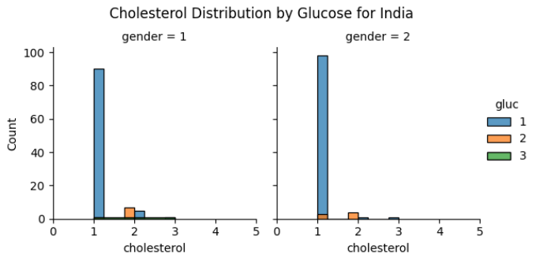
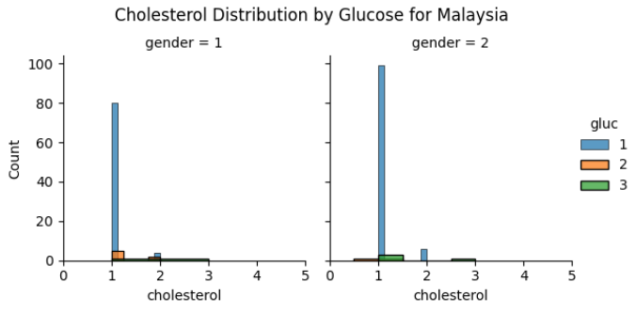
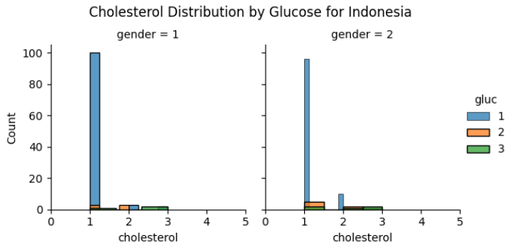
Cholesterol and Glucose (30s)

Slide 35
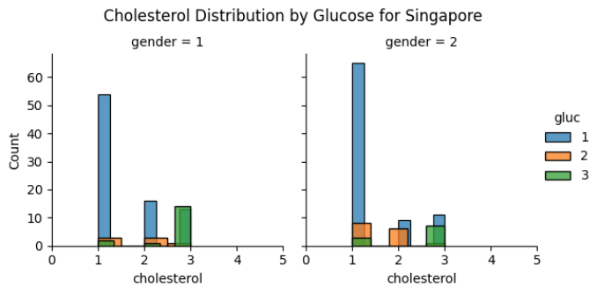
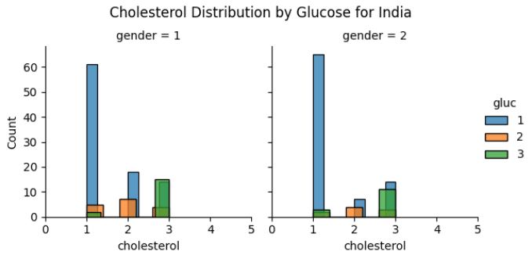
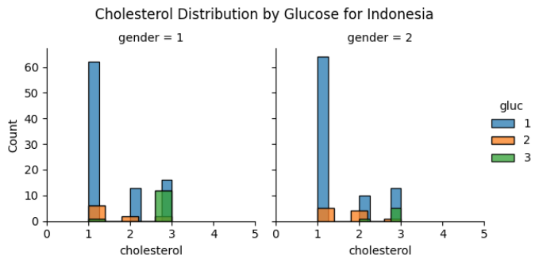
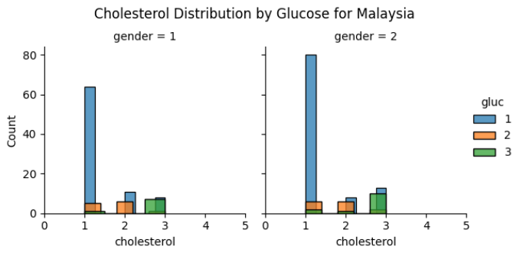
Cholesterol and Glucose (60s)
Notes:
We can see that more glucose on the moderate and high levels.

Slide 36
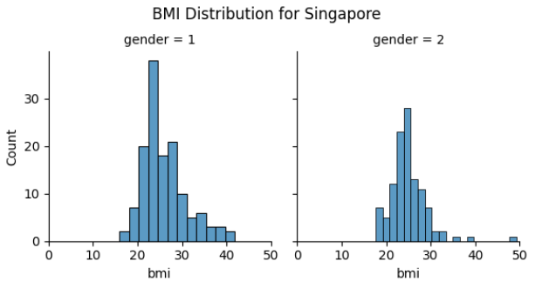
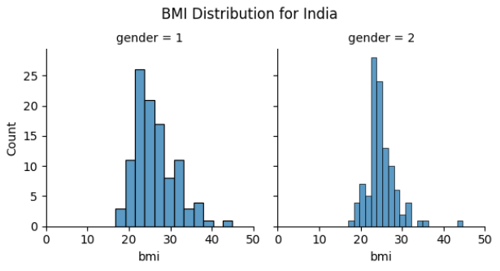
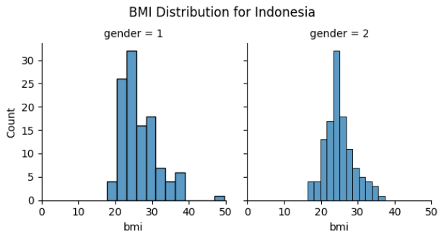
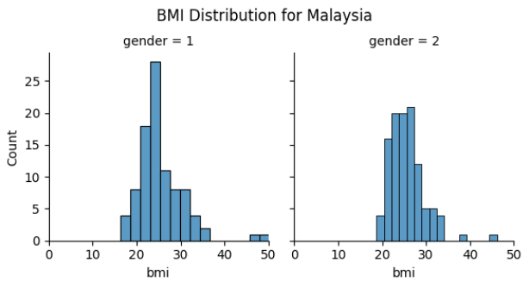
Body Mass Index (30s)

Slide 37
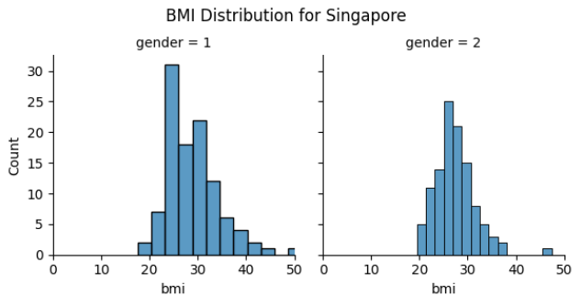
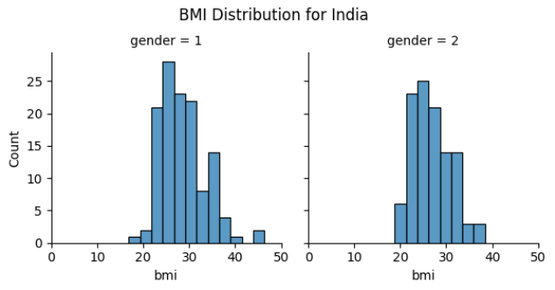
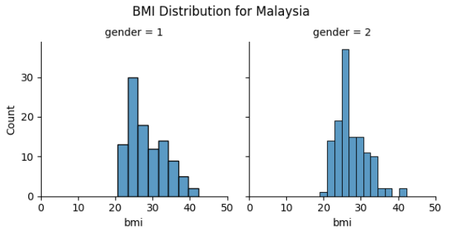
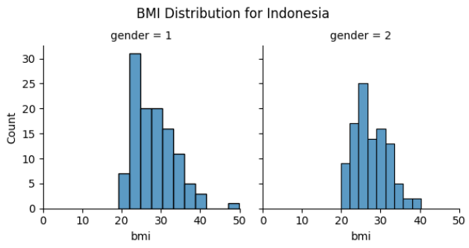
Body Mass Index (60s)
Notes:
In the 60s, we can see that the numbers are skewed more towards the right. Indicates more people are overweight.

Slide 38
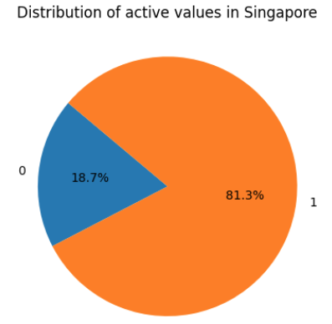
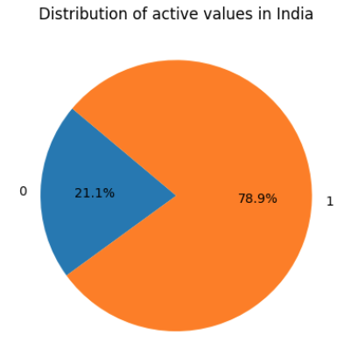
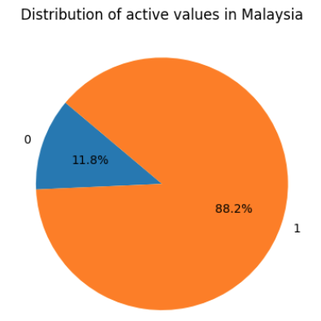
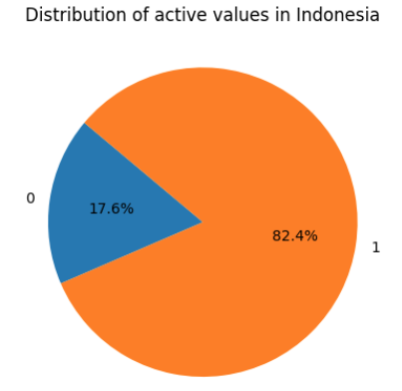
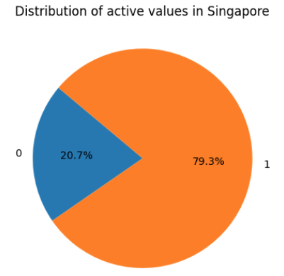
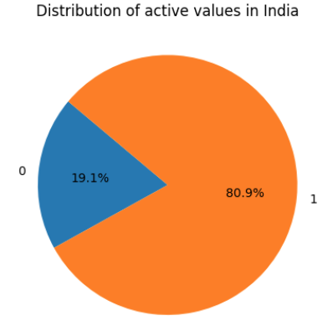
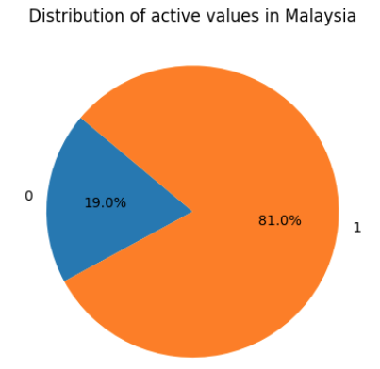

Physical Activeness
Age Group 30s Profile
Age Group 60s Profile

Slide 39

Smoking trend

Slide 40
Conclusion
For disease positive, at age above 60 if cholesterol and glucose levels are high with Body Mass Index more than standard 25. The chances of heart disease is close to 80%. While the possibility of negative is 26%.
For disease negative, in age 30s with cholesterol and glucose at low to moderate level. Even Body Mass Index more than standard 25, the chances of no heart disease is close to 90%. However, the possibility of positive is still 51%.
While smoking, physical activeness, occupation and others don’t seems to have direct influence on the possibility. However, such may affects the overall body health that could possibly leads to other implications.

